Slide 1
CS684 – Network Protocols
Session 2

Slide 2
The Link Layer (OSI layer 2)
Provides a protocol for communication over the physical medium
Provides error checking
Provides primitive flow control

Slide 3
Classifications
LAN
MAN
WAN
(GAN)

Slide 4
Topologies
Star
  Every node connected to a central node
Ring
  Each node connected to a left and right node; last node connected to first
Bus
  All nodes connected to a common cable
Meshed
  All nodes connected to every other node
Point-to-Point
  Only two nodes in the network

Slide 5
Ethernet
Most common LAN protocol today
Very inexpensive
Designed by Xerox and released into the public domain.
Controlled by the IEEE 802 working committee
Current Maximum 1GBps

Slide 6
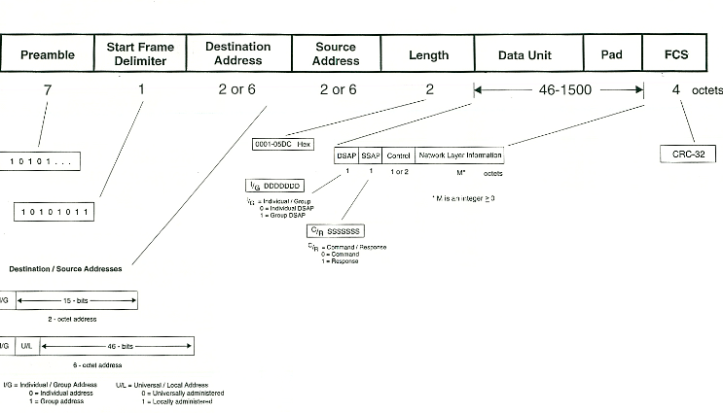
Ethernet 802.3

Slide 7

Ethernet V2

Slide 8
CSMA/CD Protocol
Carrier Sense Multiple Access with Collision Detection
  When a node has data to transmit, it first listens
  If there is silence on the network, begin transmitting; otherwise wait for silence.
  If during transmission, the voltage on the line rises above +5v, stop transmitting, generate a random number and wait that amount of time
  Restart with step 1 as necessary

Slide 9
Token-Ring
Owned by IBM
Expensive
A token is passed in around the ring
Only the station holding the ring may transmit
Current Maximum 16MBps

Slide 10
Maximum Transmission Unit
The MTU is the limit on the size of the frame
A station must not transmit a frame larger than the MTU
Ethernet V2 MTU – 1500
Ethernet 802.3 MTU - 1492

Slide 11
Internet Protocol

Slide 12
A history of IP
Originally designed by the DOD for military purposes
Used to create the DARPANET
DARPANET later evolved into the Internet for Educational purposes
Recently been utilized more for commercial purposes

Slide 13
IP Header
0 | 1 | 2 | 3 | 4 | 5 | 6 | 7 | 8 | 9 | 10 | 11 | 12 | 13 | 14 | 15 | 16 | 17 | 18 | 19 | 20 | 21 | 22 | 23 | 24 | 25 | 26 | 27 | 28 | 29 | 30 | 31 | bits
Ver |  |  |  | IHL |  |  |  | Type of Service |  |  |  |  |  |  |  | Total Length |  |  |  |  |  |  |  |  |  |  |  |  |  |  |  | IP Header | (Minumum length 20 Octets)
Identifier |  |  |  |  |  |  |  |  |  |  |  |  |  |  |  | Flags |  |  |  | Fragment Offset
Time To Live |  |  |  |  |  |  |  | Protocol |  |  |  |  |  |  |  | Header Checksum
Source Address
Destination Address
Options + Padding

